Slide 1
Basics

Slide 2
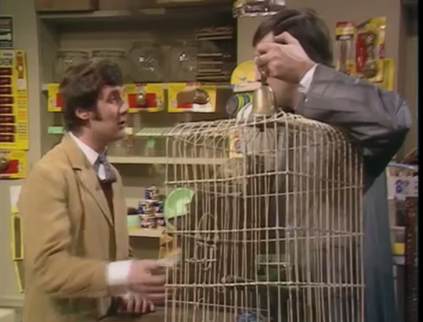
What is Python?
Python is a programming language that is often used to develop web applications.
The creator of Python, Guido van Rossum named the language after the 1970s BBC Comedy series ‘Monty Python’s Flying Circus’

Slide 3
Sequencing
The most simple type of program uses sequencing, a set of instructions carried out one after another.
Start
Display “Computer”
Display “Science”
Display “Rocks”
End

Slide 4
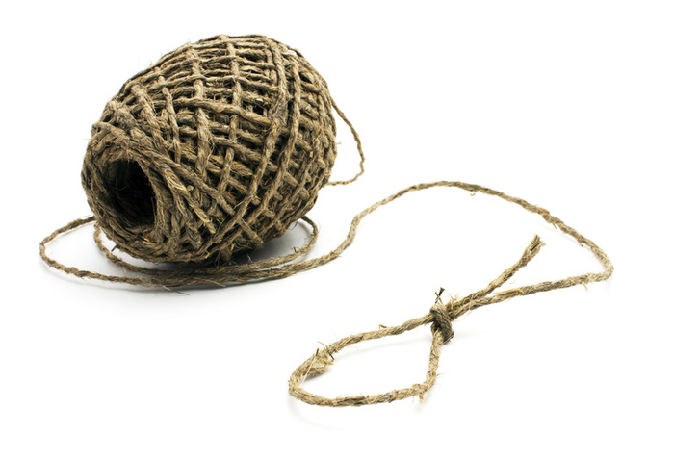
Strings
In programming we usually call normal text a string.
“What’s your name?”
A string is a collection of alphabetic and/or numeric characters.
We tell the computer something is a string by putting quote marks around it.

Slide 5



Sequencing
Match the Python code to the correct part of the flowchart.
Start
Display “Computer”
Display “Science”
Display “Rocks”
End

Slide 6
Python
Open the Python IDLE. Start a new program by clicking on File > New File.
Enter the code from the previous slide.
Save your program as sequencing.py and press F5 to run it.

Slide 7

Variables
When programming it is often necessary to store a value for use later on in the program.
A variable is a label given to a location in memory containing a value that can be accessed or changed.
Name
Think of a variable as a box with a label that you can store information in.

Slide 8

Example
Type the Python code below and press F5 to run
Start
Input Name
Display “Hello “ + name
End
Create a Python program based on the code above and save it as variables.py. Press F5 to run it.

Slide 9
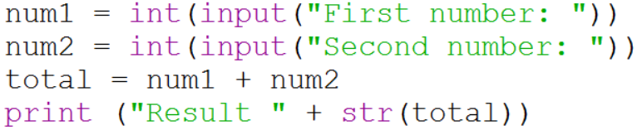
Inputting Numbers
When inputting numbers into variables you need to tell Python what data type to expect.
We use int to tell Python we are going to enter an integer (whole number). We use float when working with decimal places.
We use str to convert a number into a string.
Create a new program using this code and save it as numbers.py.

Slide 10
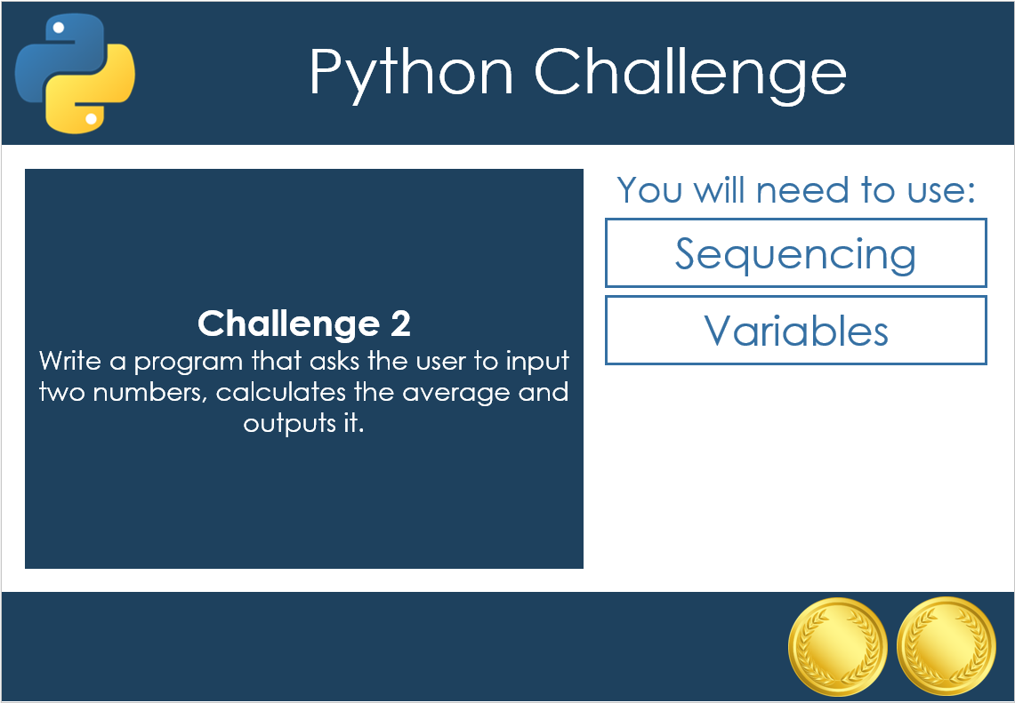
Challenges 1 to 5
Now have a go at challenges 1 to 5.

Slide 11
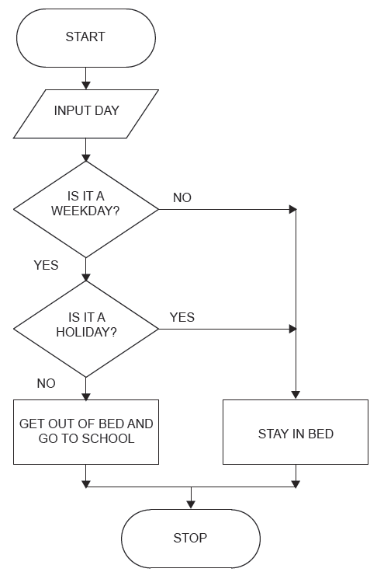
Selection
All the programs you have been developing so far have been sequential, this means that each instruction is executed in a set order.
With selection the path through a program can be decided by looking at a condition and then taking one of a set of alternative paths based on the result.
Selection in flowcharts is represented using the decision symbol.

Slide 12
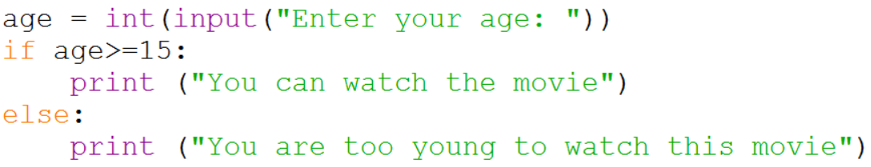
Example 1
Start
Input Age
Is Age>=15?
Yes
No
Display “You can watch this movie”
Display “You are too young to watch this movie”
End
Create the program in Python.

Slide 13
Comparison Operators
== | Is equal to
> | Is greater than
< | Is less than
!= | Is not equal to
>= | Is greater than or equal to
<= | Is less than or equal to
You can also use the logical operators AND, OR and NOT.

Slide 14
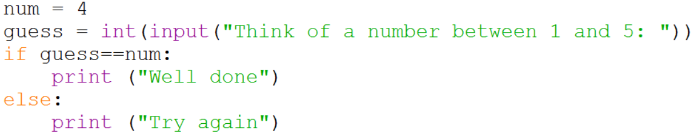
Example 2
Start
Yes
No
Complete the flowchart and then create the program in Python.
End

Slide 15
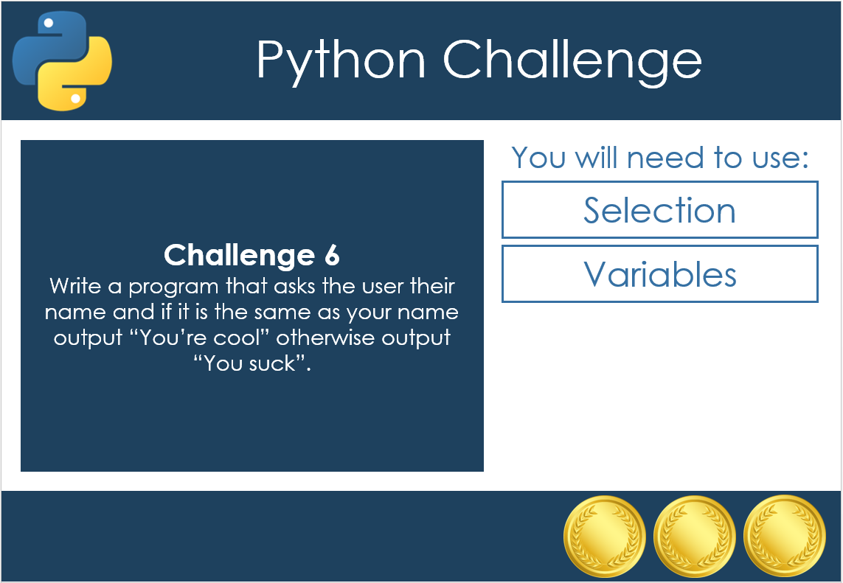
Challenges 6 to 8
Now have a go at challenges 6 to 8.

Slide 16
Repetition
We use repetition to prevent typing the same code out many times and to make our code more efficient.
FOR is used when you know how many times you want to do something, WHILE is used when you don’t.

Slide 17
FOR Loops
FOR is used when you know how many times you want to do something.
Start
x = 1
x < 13
The following program will output the multiplication table for 7 from 1 up to 12 ‘times’.
No
Yes
Display x*7
x = x + 1
End

Slide 18

Loop Counter
The variable x in a for loop is used as a loop counter. It contains the number of times the loop has run.
See this for yourself by trying out this code:

Slide 19
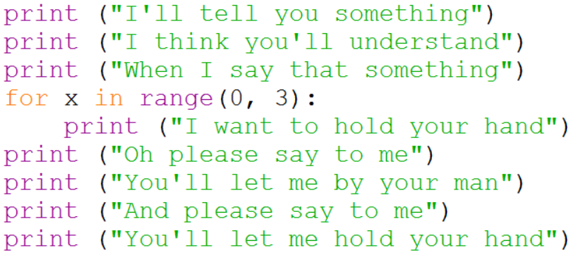
Example
Below is a program developed to output the lyrics of the Beatles song ‘I Want to Hold Your Hand’. Write a program to output the lyrics of your favourite song using a For loop for repeated lines.

Slide 20
WHILE Loops
FOR is used when you know how many times you want to do something, WHILE is used when you don’t.
Start
Input Password
The following program keeps on asking the user to enter their password until they enter it correctly.
password
<>
realpass
No
Yes
Display “Correct”
End

Slide 21
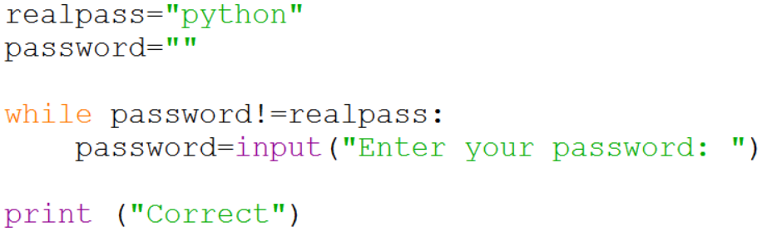
Example
The following program keeps on asking the user to enter their password until they enter it correctly. Try it for yourself.

Slide 22
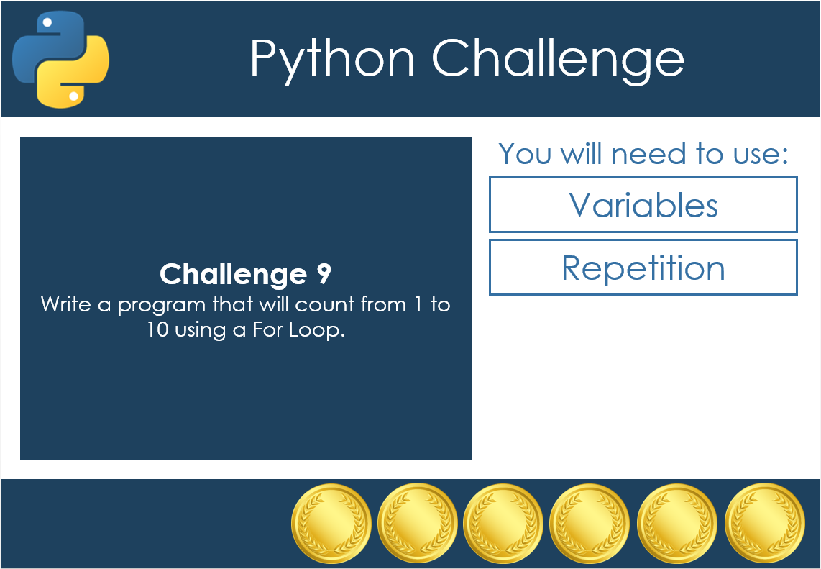
Challenges 9 to 12
Now have a go at challenges 9 to 12.

